Slide 1
STATIC TESTING
Introduction
Static Testing (as distinct from dynamic testing) is a form of software testing that involves a systematic examination of the software code and documentation without execution of the code.

Slide 2
Static Testing vs. Dynamic Testing

Slide 3
Types of Static Testing
01
Code Analysis
02
Code Reviews
03
Structured Walk-throughs
04
Informal Reviews
05
Software Inspections

Slide 4
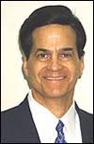
Michael Fagan
Software Engineer
Developed Fagan Inspection methodology (Fagan 1976)

Slide 5
Economic Benefits of Software Inspections
Software inspections are useful for educating new employees on the product and on the standards and procedures used in the organization. They ensure that knowledge is shared among the employees, rather than understood by just one individual. Inspections improve software productivity, as less time is spent in correcting defective software.

Slide 6
Informal Reviews
This type of review involves reviewers sending comments directly to the author (e.g. email or written), and there is no actual review meeting.
It helps in identifying some of the defects in the work products, but its success is dependent on the extent to which the reviewers are proactive in sending comprehensive comments to the author by the due date.
The author is responsible for making sure that the review happens, and advises the participants that comments are due by a certain date. The author analyses the comments received, makes the required changes, and circulates the document for approval

Slide 7
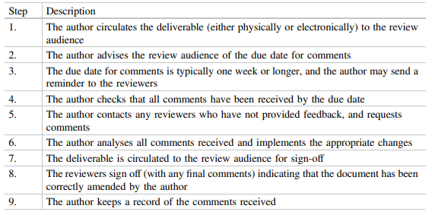
The Activities of Informal Reviews

Slide 8
Structured Walk-through
A structured walk-through is a peer review in which the author of a deliverable (e.g. a project document or actual code) brings one or more reviewers through the deliverable.
The objective is to get feedback from the reviewers on the quality of the document or code, and to familiarize the review audience with the author’s work

Slide 9
Roles of Walk-through
01
02
03
04
The Review Leader
The Author
The Scribe
The Review Audience

Slide 10
Simplified Version of Fagan Inspection
Is a moderated review meeting chaired by the review leader. The author selects the reviewers and appoints a review leader (who may be the author). The review leader chairs the meeting and verifies that the follow-up activity has been completed. The author distributes the deliverable to be reviewed and provides a brief overview of the material. This section is adapted from O’Hara

Slide 11
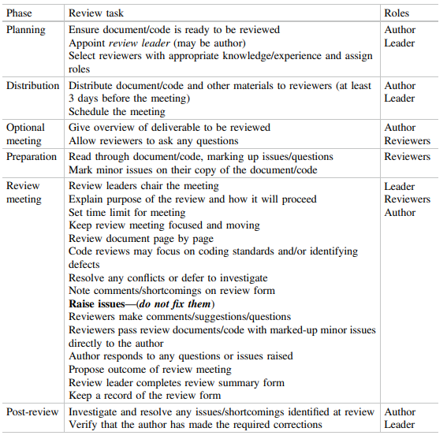
Activities for Semi-Formal Review Meeting

Slide 12
The semi-formal review process works well when the review leader is not the author, as otherwise there is a risk that the review may be ineffective, and that the follow-up activity may not be done. It may work with the author acting as review leader provided the author has received the right training on the review process and consistently follows the process.

Slide 13
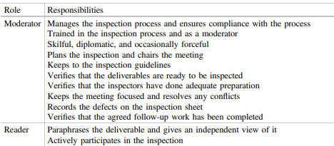
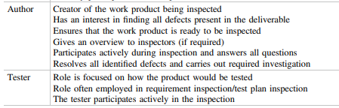
Four Inspector Roles in
Fagan Inspection

Slide 14
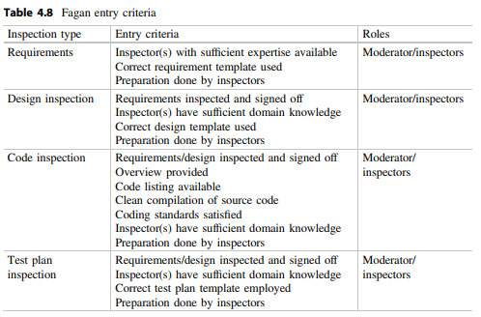
Entry criteria for the various types of inspections are specified in Table 4.8 and should be satisfied for an effective inspection.

Slide 15
Preparation
is a key part of the process, as the inspection will be ineffective if insufficient time is devoted to understanding and reviewing the deliverables prior to the inspection meeting. Consequently, the moderator is required to cancel the inspection if the inspectors are insufficiently prepared.

Slide 16
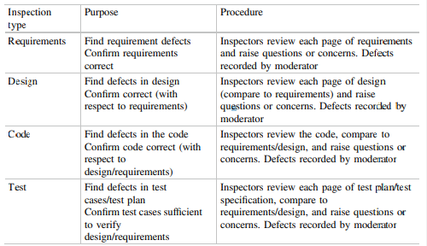
The Inspection Meeting
The Inspection Meeting consists of a formal meeting between the author and at least one inspector. It is concerned with finding defects in the particular deliverable and verifying its correctness.

Slide 17
Effectiveness of Inspection
– The expertise and experience of the inspector(s)
– Preparation done by inspector(s)
– The speed of the inspection.

Slide 18
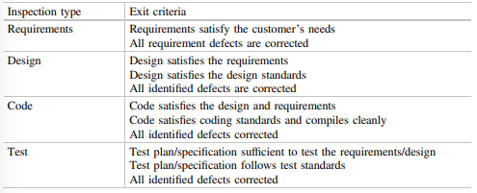
Inspection Exit Criteria

Slide 19
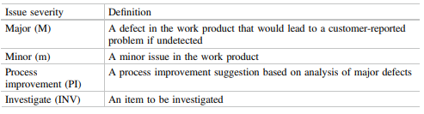
Issue Severity
The severity of an issue identified in the Fagan inspection may be classified as major, minor, a process improvement item, or an item requiring further investigation. It is classified as major if its non-detection would lead to a defect report being raised later in the development cycle, whereas a defect report would generally not be raised for a minor issue.

Slide 20
Defect Types
There are several defect-type classification schemes employed in software inspections. These includes:
Fagan Inspection Defect Classification
Orthogonal Defect Classification Scheme

Slide 21
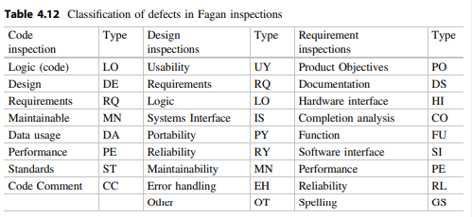
Fagan Inspection Defect Classification

Slide 22
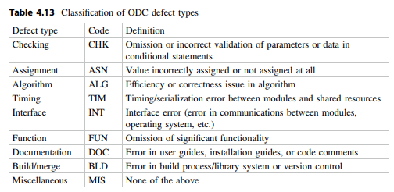
Orthogonal Defect Classification Scheme
The orthogonal defect classification (ODC) scheme was developed at IBM (Bhandari 1993), and it classifies a defect into three orthogonal viewpoints.
The ODC yields a rich pool of information about the defect, but effort is required to record this information. The defect-type classification is described in Table 4.13.

Slide 23
Defect Trigger
is the catalyst that led the defect to manifest itself.
Defect Type
indicates the change required for correction.
Defect Impact
indicates the impact of the defect at the phase in which it was identified.

Slide 24
The Automated Software Inspection tools provide quality assessment reports on the extent to which the coding standards are satisfied, as well as quality metrics on code complexity.
They provide warnings about potentially problems with the complexity of the design with metrics that have a high complexity measure
Notes:
In summary, automated inspections offer advantages in terms of efficiency, accuracy, safety, and cost-effectiveness, making them a valuable tool across a wide range of industries.

